Slide 1
ATM MANAGEMENT SYSTEM
BY:
MOHAMADOU MOCTAR 160041082
ABDOUL LATIF HAMADOU 160041084
MIKAYILOU NAMBA 160041085
HAYATOU AMADOU 160040020(HD)
ABDOULBAGUI BOUBAKARI 160040019(HD)
SUPERVISED BY: Mr. ABDULLAH-AL-TARIQ

Slide 2
CONTENTS
INTRODUCTION
CUSTOMER
EXIT

Slide 3
INTRODUCTION
Mostly used by banks ATM stands for :
Automated Teller Machine.
It is machine that dispenses cash or performs other banking services when an account holder inserts a bank card.
It's a specialized computer which deals with somes programs and makes it convenient to manage your money.
For example, almost all ATMs allow you to withdraw money, and many allow you to make deposits. ... You can usually access the most services at an ATM that's operated by your own bank.

Slide 4
Our PROJECT is based on the ATM MANAGEMENT SYSTEM.
This Program is designed to enable both BANK and Customers having activities with the ATM to interact in simple way with the system.
It reduces the work of the BANK and improves the Management of the money.
The customer can perform many type of operation such as cash deposit, fund transfer, pin change ,balance inquiry, fast cash, cash withdraw ……..
the admin of the bank can check at anytime the activities in the shop

Slide 5
The account pin of the customer is protected. The customer should enter the required password to be allow to make any actions.
Here, the pin is By default : 123
Next slide shows the Main Menu

Slide 6
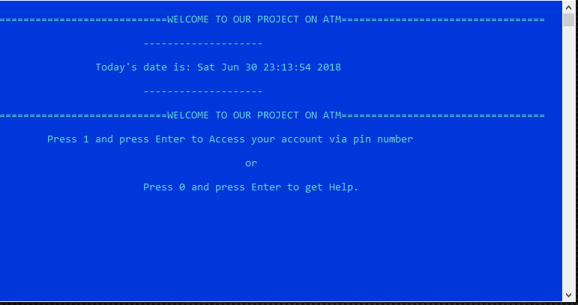
Main Menu

Slide 7
CUSTOMER
After typing his pin, the customer is the one who is allowed to make all the transaction that he want in the atm .
Usually, in an atm the customer is allow to:
CASH DEPOSIT
CASH WITHDRAWAL
BALANCE INQUERY
BILLS PAYMENT
INTEREST PAYMENT

Slide 8
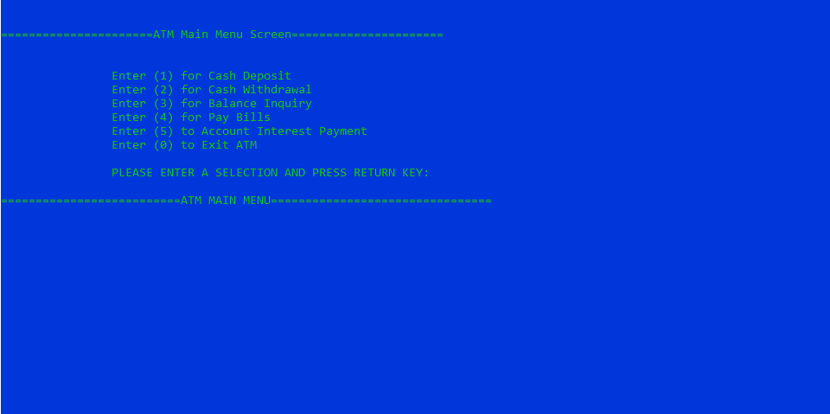
These are the actions taken by the customer

Slide 9
Cash Deposit: Here, the customer can transfer money into his account by giving cash at the bank teller, via money transfer or in our case via ATM machine.
Cash withdrawal: In this case it is about removing fund from the atm.
Balance enquiry: this option is about checking the card balance in real time through the ATM

Slide 10
Bills payment: Here you can pay most of your bills via this atm and this is working only for the companies witch are working in collaboration with the bank. So you pay for the electricity, for the water, for the house renting and so on……….
Interest: This part is calculating the interest that you gain annually.

Slide 11
END

Slide 12
THANK YOU FOR LISTNING TO US

